Slide 1
Pemberitaan Ekonomi Indonesia oleh Media Keuangan dan Bisnis Global
github.com/ProjectA3BD/nlp
Disiapkan oleh:
Bagus Kharisma N. (10)
Bakhtiar Amaludin (11)
Darmawan Nur Kusuma (12)
Eman Sukmana (13)
Febrina Puspa (14)
Dataset: 1200++ Artikel, 2016-2018

Slide 2
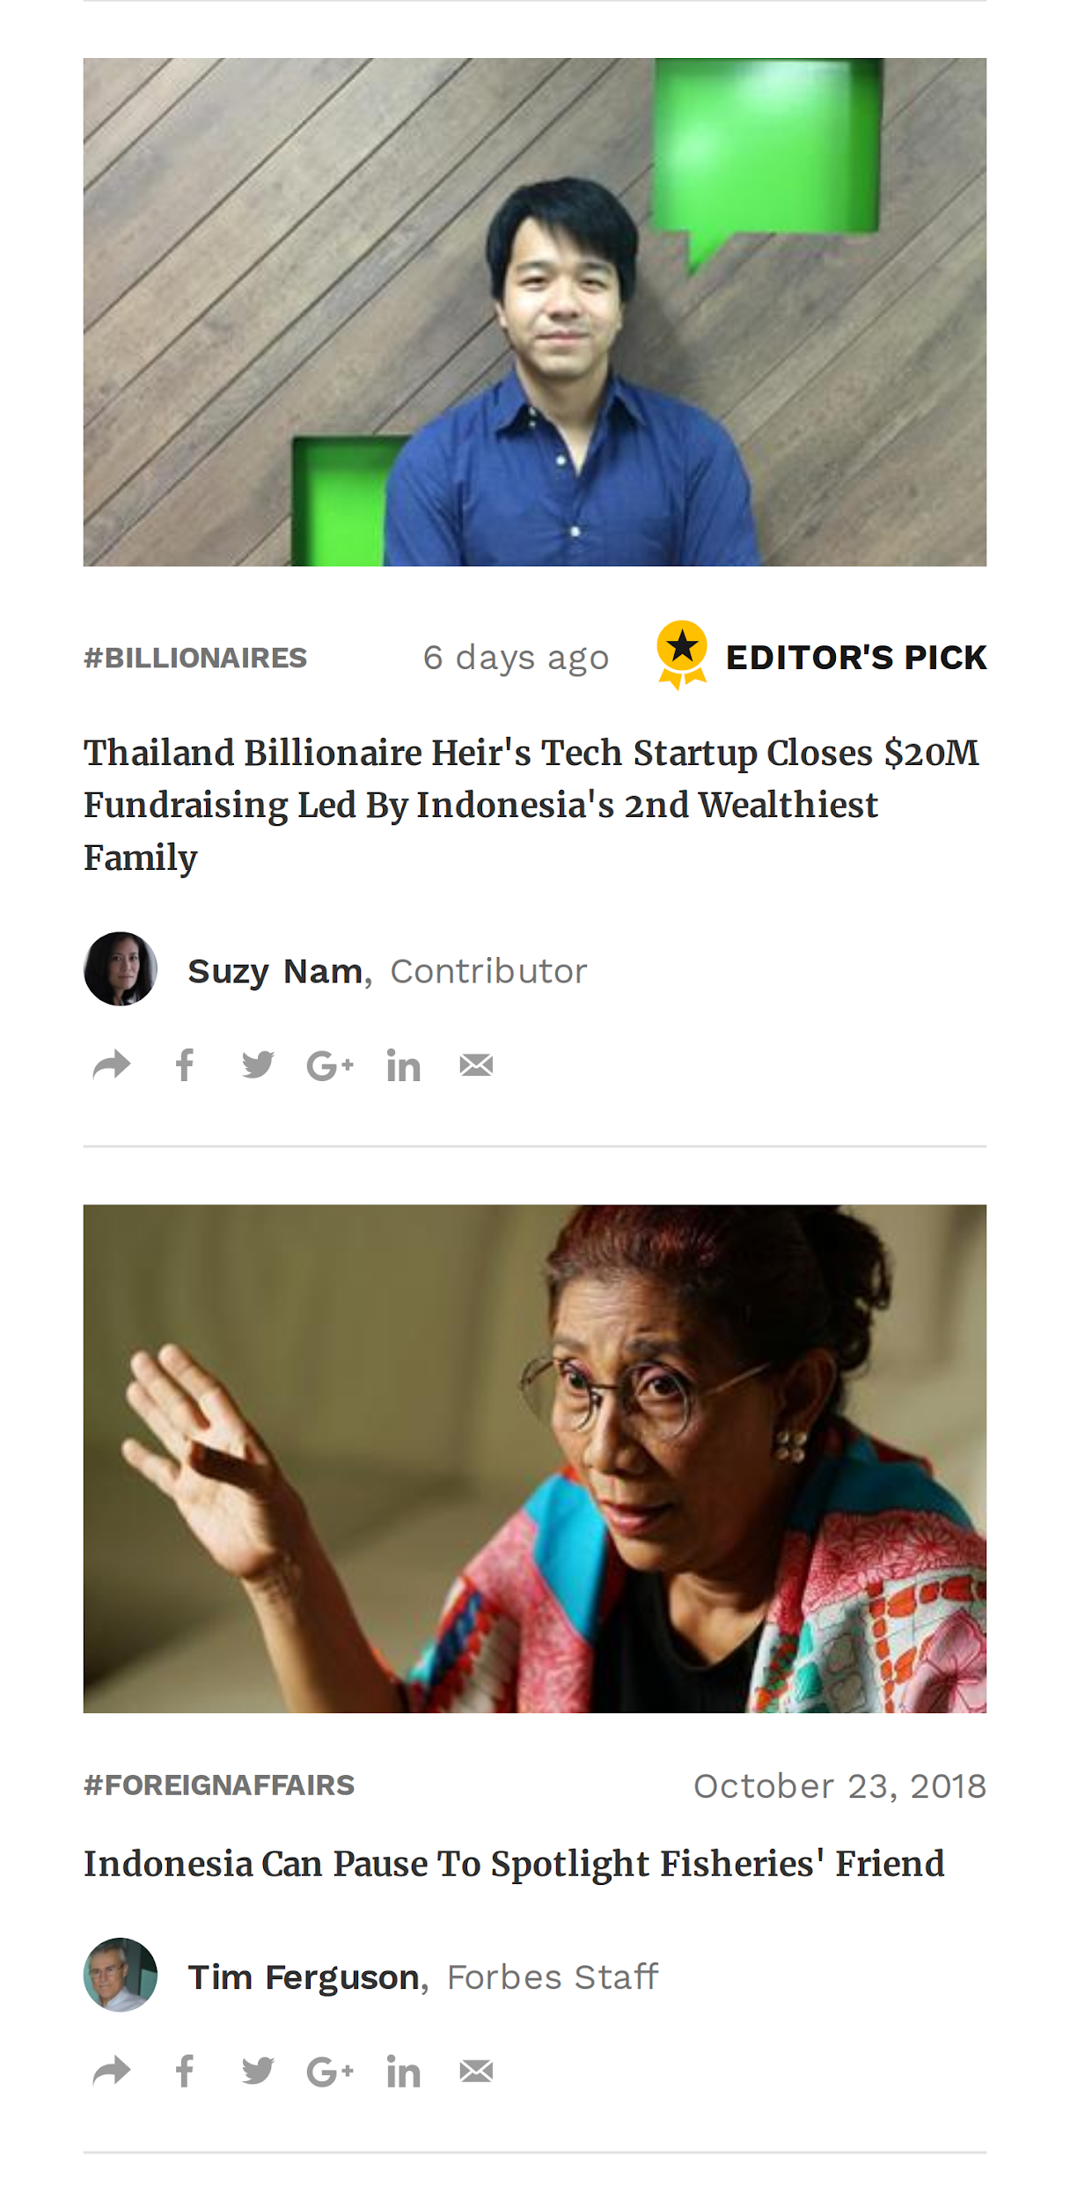
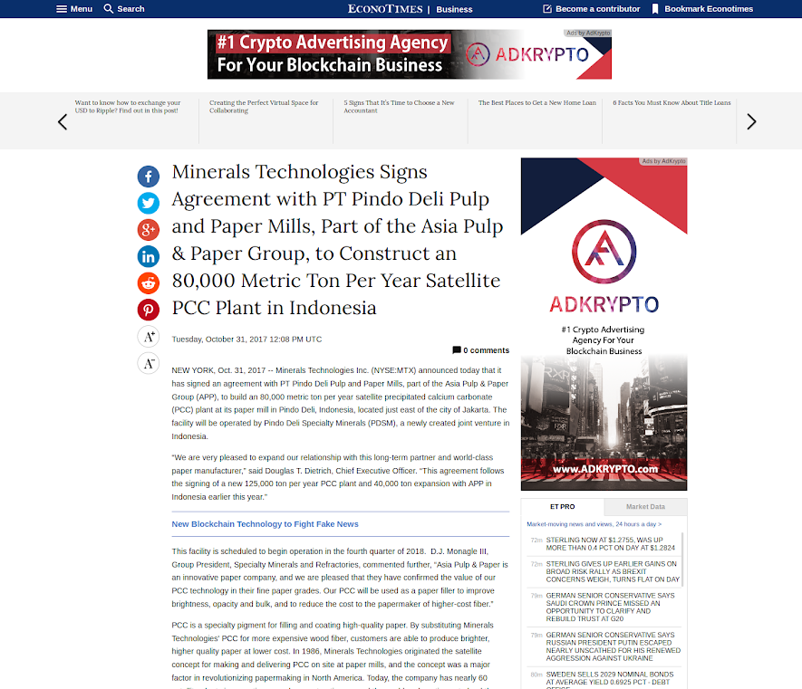
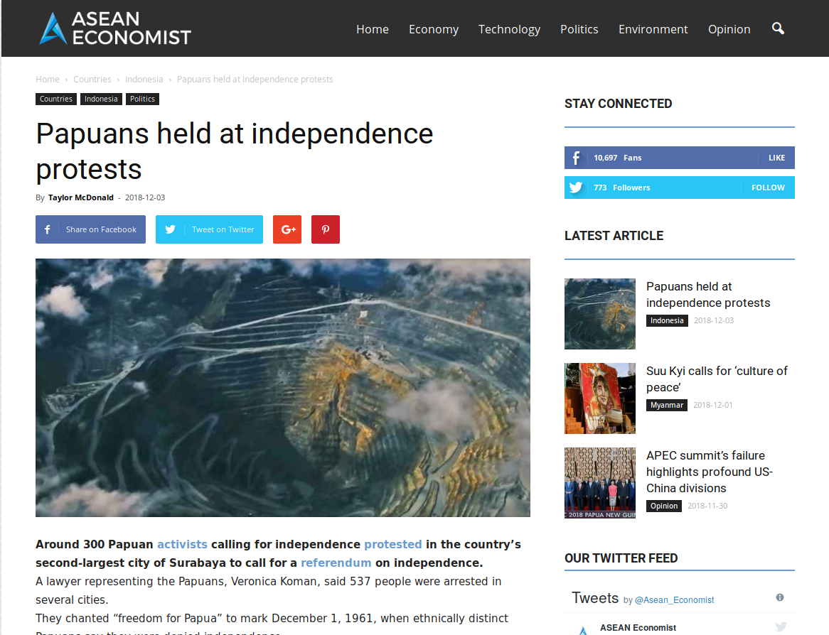
Pemberitaan Ekonomi Indonesia
1200++ Artikel, 2016-2018

Slide 3
Algoritma ML
Sentiment Analysis
Clustering
1
Data Preparation and Preprocessing
Scrapping (inc. Deduplication)
Labeling
Split Test
Feature Extraction
2
Learning
Naive Bayes
SVM
3
Testing
Confussion Matrix
Accuracy Score
4
Validation
K-Fold Cross Validation
Average Accuracy
1
Data Preparation and Preprocessing
Scrapping (inc. Deduplication)
Split Test
Feature Extraction
2
Learning
K-Means
MiniBatch K-Means
3
Find Optimal Cluster
Apply Model
DBI Score
4
Labeling and Testing
Set Label
Predist test data

Slide 4
Algoritma ML
ML Task | Algorithm | Keterangan
Sentiment Analysis | Naive Bayes | train_test_split = 0.2 cross validation = 5
 | SVM | train_test_split = 0.2 kernel='linear' cross validation = 5
Clustering | K-Means | n_clusters = 8 init='k-means++' max_iter=100
 | MiniBatch K-Means | n_clusters = 9, batch_size=1
Dataset: 1200++ Artikel, 2016-2018

Slide 5
Contoh Perhitungan (Labelisasi)
Positif = AvgTone >= 1
Negatif = AvgTone <= 1
Netral = -1 > AvgTone < 1
Judul | AvgTone | Sentimen
Indonesia delays rules for reporting credit card customer data | 2.12 | Positif
Terrorists channeling funds into South-east Asia, says risk study | -4.122 | Negatif
Indonesia allows tax amnesty seekers to purchase gold, property | 0.212 | Netral

Slide 6
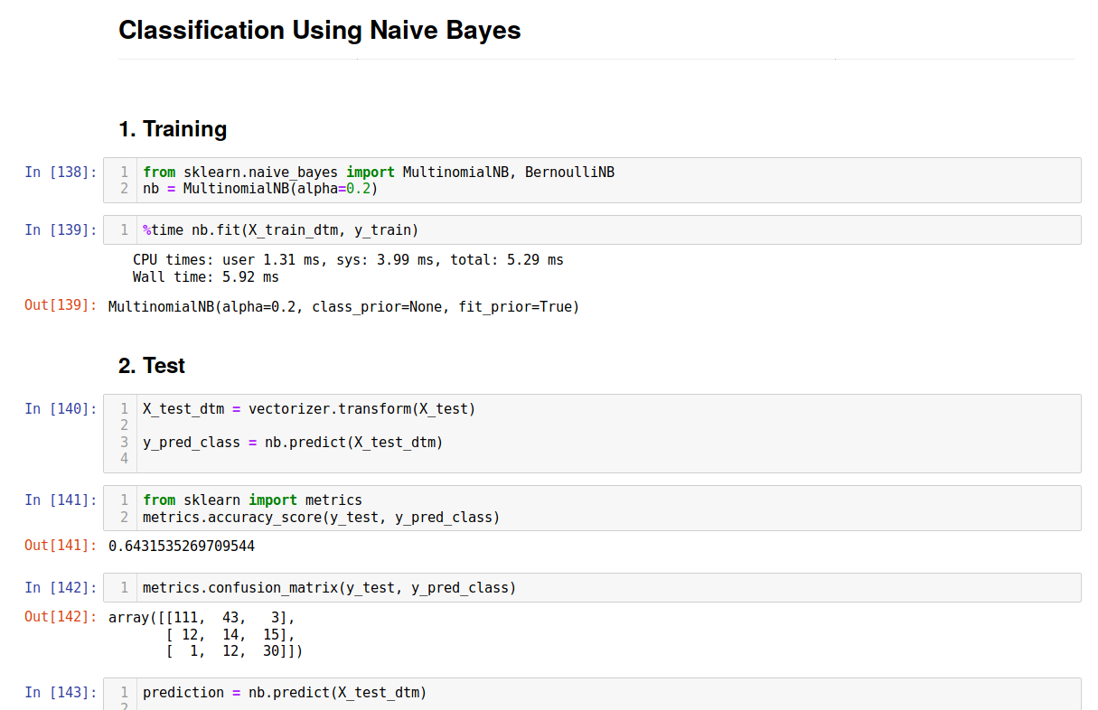
Contoh Perhitungan (Naive Bayes)
github.com/ProjectA3BD/nlp

Slide 7
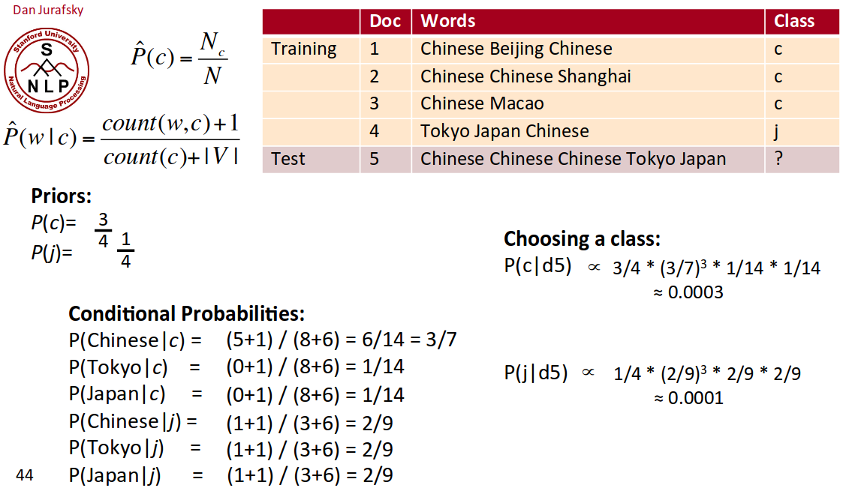
Contoh Perhitungan (Naive Bayes)
github.com/ProjectA3BD/nlp

Slide 8
Contoh Perhitungan
Judul | Sentiment | Prediksi
Indonesia delays rules for reporting credit card customer data | +1 | +1
Terrorists channeling funds into South-east Asia, says risk study | -1 | -1
Indonesia allows tax amnesty seekers to purchase gold, property | 0 | 0
Judul | Cluster
INVESTOR ALERT: Investigation of Freeport-McMoRan Inc. Announced by Law Offices of Howard G. Smith | Energy & Mining
India, Singapore central bankers call for global safety net | Finance

Slide 9
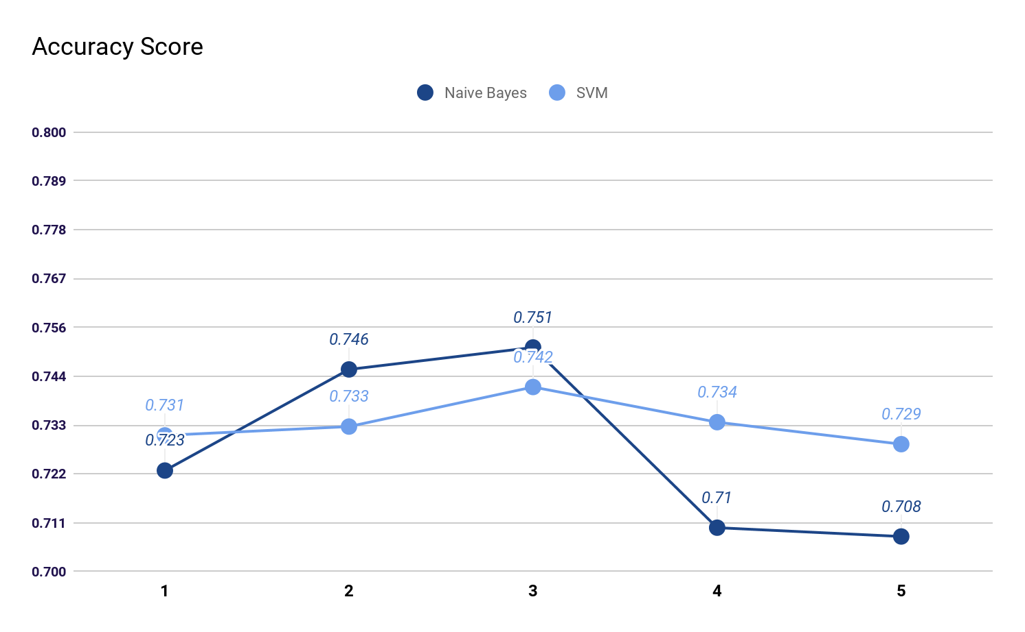
Hasil Sentiment Analysis
Naive Bayes - CM
Cross Validation Score (k = 5)
Accuracy: 0.814
SVM - CM
NB Average: 0.72
Accuracy: 0.751
SVM Average: 0.73
151 | 6 | 1
17 | 13 | 9
6 | 6 | 33
142 | 13 | 2
17 | 12 | 12
8 | 8 | 27

Slide 10
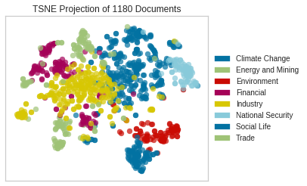
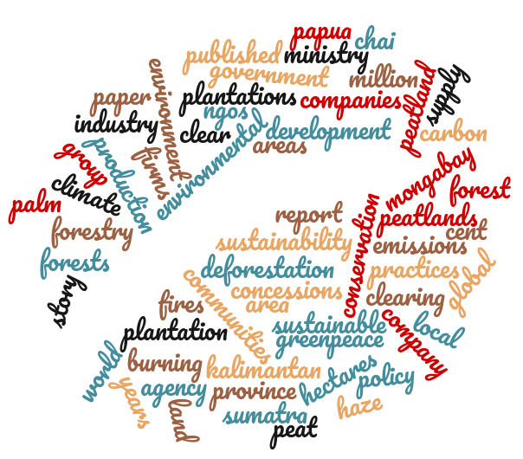
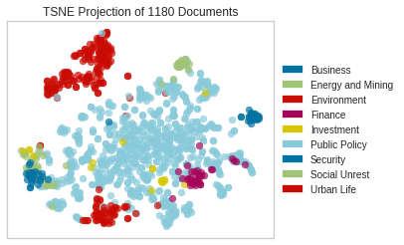
Hasil Clustering
DBI Score:
K-Means
MiniBatch K-Means
n | K-Means | MiniBatch K-Means
6 | 1.107 | 1.222
7 | 1.101 | 1.015
8 | 0.676 | 0.801
9 | 0.734 | 0.481
10 | 0.730 | 0.586

